Slide 1

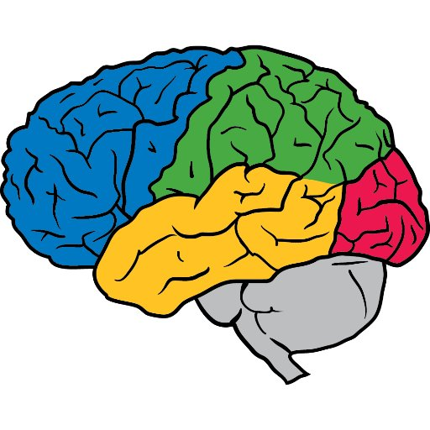
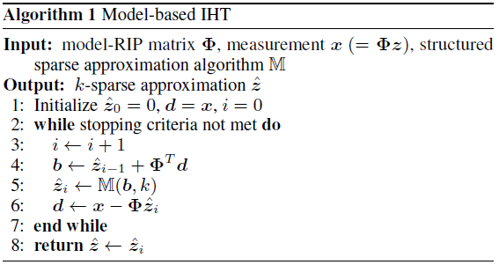
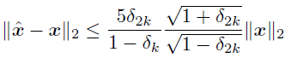
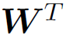
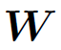
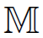
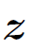
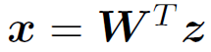
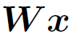
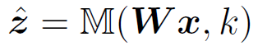
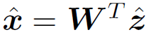
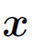
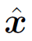
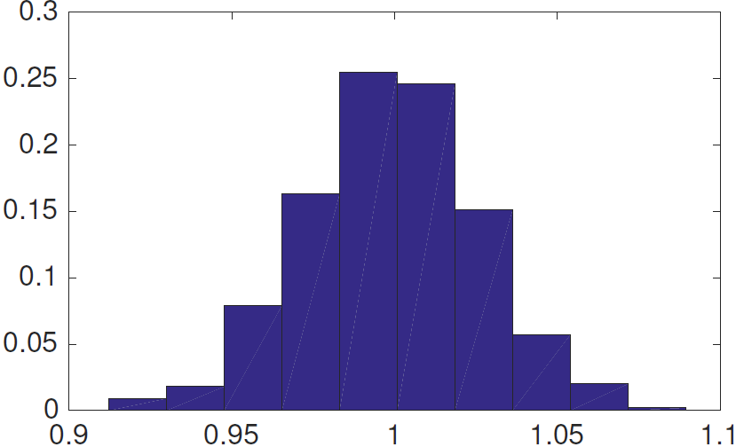
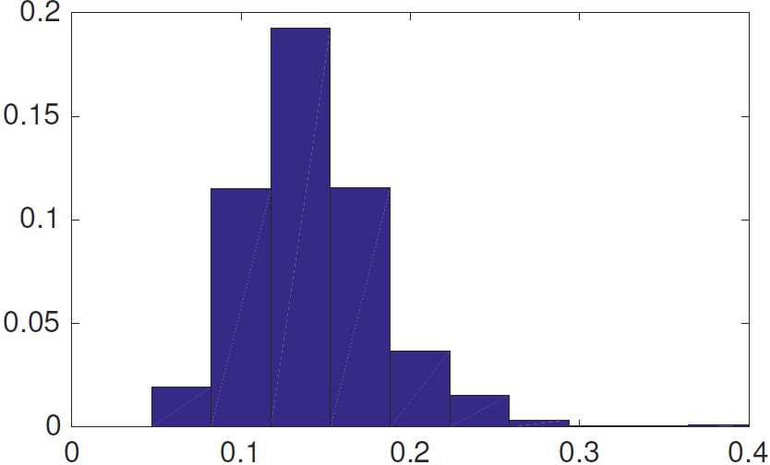
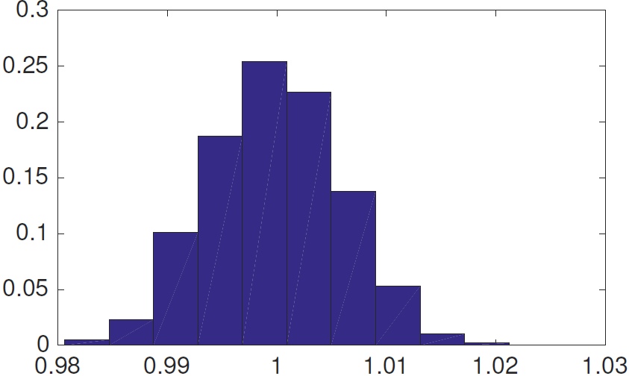
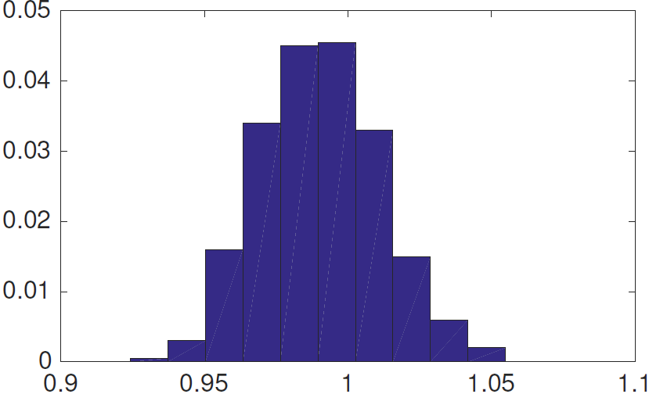
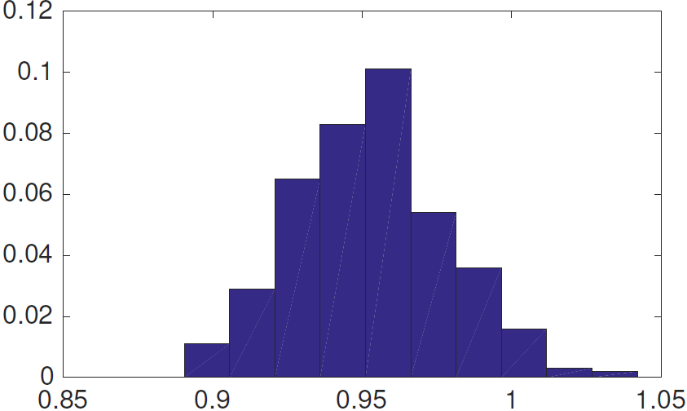

Towards Understanding the Invertibility of Convolutional Neural Networks
Anna C. Gilbert¹, Yi Zhang¹, Kibok Lee¹, Yuting Zhang¹, Honglak Lee^{1,2}
¹University of Michigan
²Google Brain
1
Invertibility of CNNs
Reconstruction from deep feature representation obtained by CNNs is nearly perfect.
Stacked “what-where” autoencoders (SWWAE) (Zhao et al., 2016)
Unpooling max-pooled values (“what”) to the known switch locations (“where”) transferred from the encoder
Max pooling without switches
1 | 5 | 4 | 4
2 | 6 | 7 | 9
8 | 0 | 1 | 5
3 | 3 | 2 | 6
6 | 9
8 | 6
6 | 0 | 9 | 0
0 | 0 | 0 | 0
8 | 0 | 6 | 0
0 | 0 | 0 | 0
SAE Dosovitskiy & Brox (2016)
Max pooling with switches
SWWAE
Zhang et al. (2016)
1 | 5 | 4 | 4
2 | 6 | 7 | 9
8 | 0 | 1 | 5
3 | 3 | 2 | 6
6 | 9
8 | 6
0 | 0 | 0 | 0
0 | 6 | 0 | 9
8 | 0 | 0 | 0
0 | 0 | 0 | 6
CNNs and compressive sensing
Theoretical analysis
2
3
a. Components of CNNs and decoding networks
a. Transposed convolution operator (W^{T}) satisfies model-RIP
Conv
Pool
Output
Unpool
Deconv
This can be proved based on the fact that
The output of CNNs is model-k-sparse, as pooling + unpooling can be seen as a block sparsification.
(De)convolution is multiplicative.
Gaussian random CNNs are not too far from the state-of-the-art CNNs.
So we can analyze CNNs by the theory of compressive sensing.
Input
Switch
Recon
Convolution
Pooling
Nonlinear function (ReLU)
Shang et al. (2016): learned CNN filters with ReLU tend to come in positive and negative pairs, thus ReLU is invertible
Need analysis
b. Convolution + pooling == One iteration of IHT
f(x) = max(0,f(x)) - max(0,-f(x))
Iterative hard thresholding (IHT) is a sparse signal recovery algorithm. (Blumensath and Davies, 2009)
So we can translate the encoding- deconding networks to
b. Compressive sensing
Encoder | Decoder
Convolution | Transposed convolution
Pooling + Unpooling
Compressive sensing
Acquiring & reconstructing a signal in an underdetermined system Φ
Restricted isometry property (RIP)
For a vector z with k non-zero entries, ∃ δ_{k} > 0 s.t.
Nearly orthonormal on sparse signals
Model-RIP
RIP for a “model-k-sparse” vector
Reconstruction bound
For distortion factors 0 < δ_{k}, δ_{2k} < 1,
Calculation of distortion factors is strongly NP-hard.
We can observe the empirical reconstruction errors to measure the bound.
K blocks
k non-zero entries (k < K)
4
Empirical observation
a. 1-d architecture for experiment
b. 2-d architecture for experiment (VGGNet-16)
: Conv(5,1)
: Deconv(5,1)
c. Model-RIP condition and reconstruction error
Image
Encoder
: Pool(4)
Switch
: Unpool(4)
Decoder
Recon
Histograms show that the models satisfy model-RIP and empirical reconstruction errors are around 0.1 ~ 0.2
d. Image reconstruction
(a) Original images
(b) Learned decoder
(c) IHT with learned weights
(d) IHT with random weights
(d) Random activation by learned decoder
1-d random model-RIP condition | 1-d random recon error | 2-d random model-RIP condition | 2-d VGG without ReLU model-RIP condition | 2-d VGG with ReLU model-RIP condition
Reconstruction error for 2-d experiment
Macro layer | Image space relative error |  |  | Activation space relative error
 | (d) Random filters | (c) Learned filters | (e) Random activations | (d) Random filters | (c) Learned filters | (e) Random activations
1 | 0.380 | 0.423 | 0.610 | 0.872 | 0.895 | 1.414
2 | 0.438 | 0.692 | 0.864 | 0.926 | 0.961 | 1.414
3 | 0.345 | 0.326 | 0.652 | 0.862 | 0.912 | 1.414
4 | 0.357 | 0.379 | 0.436 | 0.992 | 1.051 | 1.414
Content information is preserved in the hidden activation.
Spatial detail information is preserved in the pooling switches.
Main references:
Blumensath and Davies, Iterative hard thresholding for compressed sensing, Applied and Computational Harmonic Analysis, 2009
Baraniuk et al., Model-Based Compressive Sensing. IEEE Transactions on Information Theory, 2010
Zhang et al., Augmenting supervised neural networks with unsupervised objectives for large-scale image classification, ICML 2016
Shang et al., Understanding and improving convolutional neural networks via concatenated rectified linear units, ICML 2016

